Slide 1
E-Commerce Performance Analysis
Data-Driven strategy for E-Commerce Platform
Data Source Credit: Kaggle (Brazilian E-Commerce Public Dataset by Olist)
Presented By: Jeet Sarkar
Technical Credit: Excel, SQL, Power BI

Slide 2
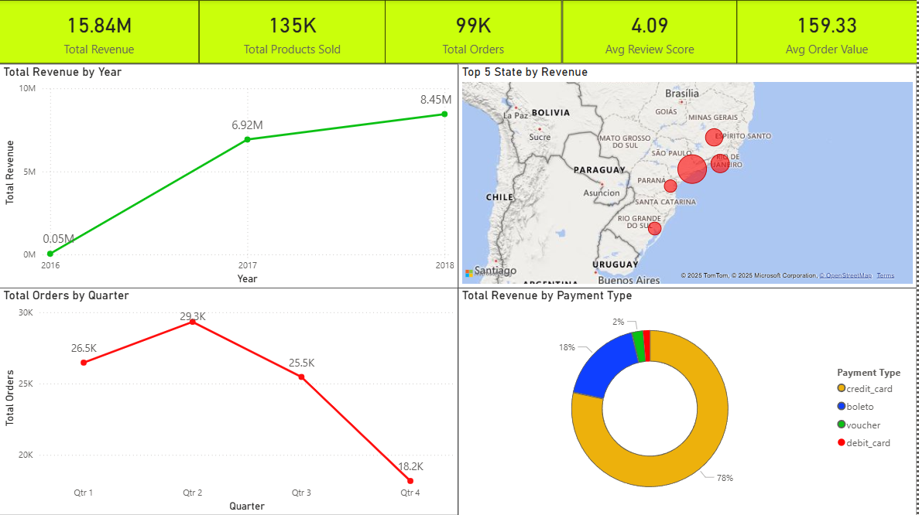
Sales & Revenue Analysis
Key Insights:
Strong Revenue Growth: Total Revenue has grown dramatically from $0.05M in 2016 to $8.45M in 2018.
Payment Dominance:
  Credit Card accounts for 78% of revenue.
  Boleto is second highest at 18%.
Order Volatility: Total Orders show a distinct seasonal pattern:
  Peak in Q2 (29.3K orders).
  Drop in Q3 (25.5K orders).
  Significant decline in Q4 (18.2K orders).
Geographic Concentration: Top 5 states by revenue are concentrated in southeast/south Brazil, with Sao Paulo (SP) leading.

Slide 3
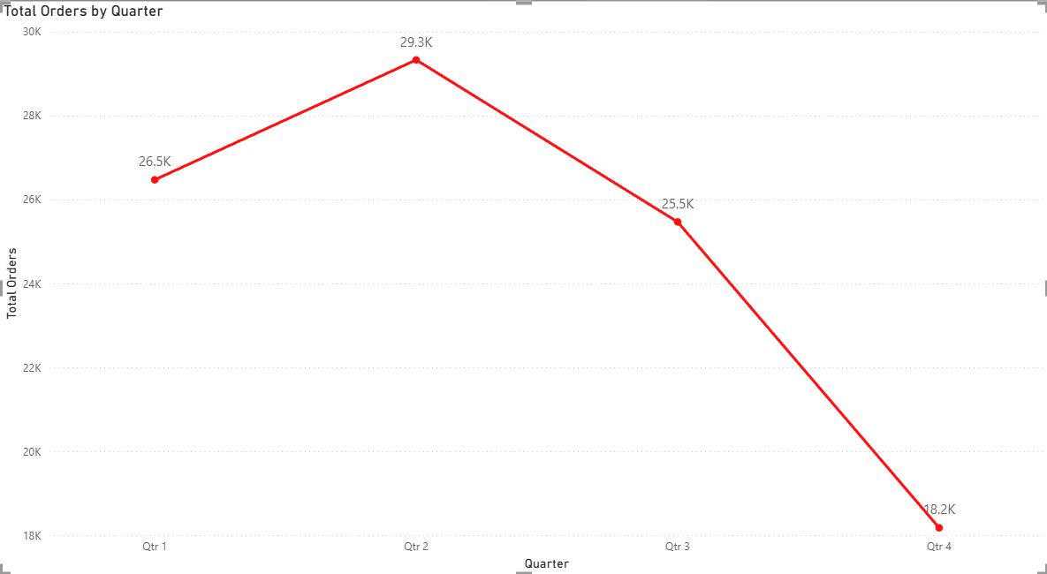
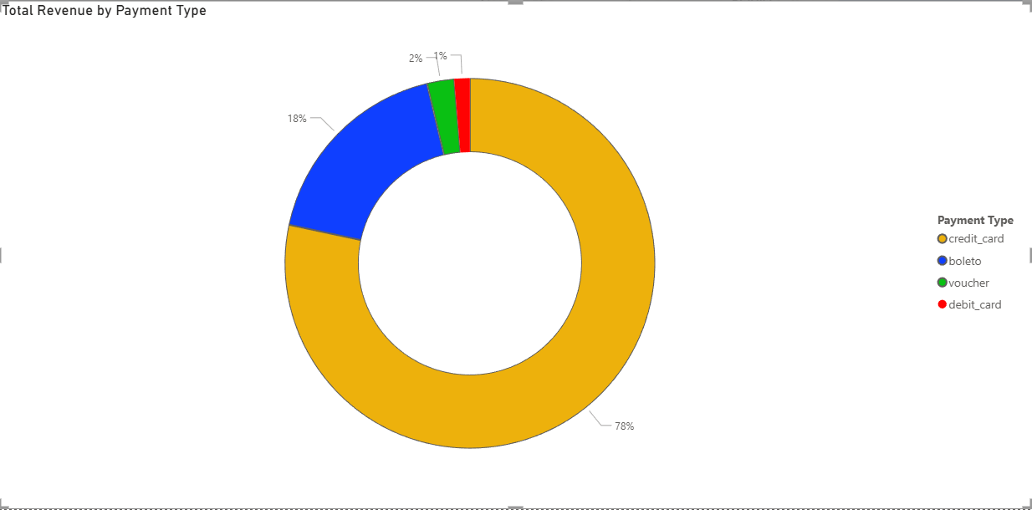
Recommendations:
Q4 Strategy: Develop robust Q4 marketing and sales campaigns to mitigate the sharp drop in orders.
Payment Method Incentives:
  Optimize credit card transaction costs.
  Offer incentives for customers to use Boleto (18%) to increase its usage.

Slide 4
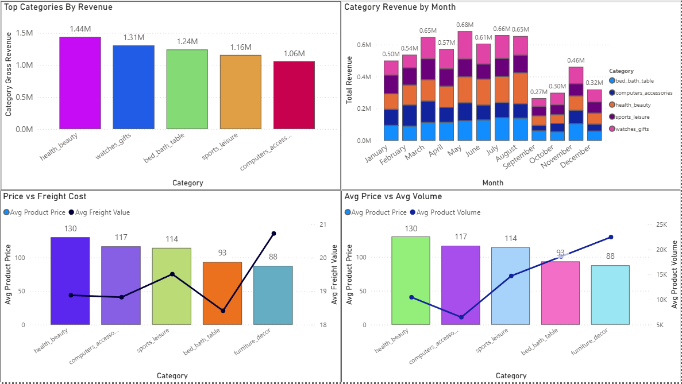
Product & Category Analysis
Key Insights:
Top Categories:
  Health & Beauty: $1.44M
  Watches & Gifts: $1.31M
  Computers & Accessories: $1.06M
Monthly Revenue Drivers: In peak months (March, May, July), Bed & Bath/Table, Computers & Accessories, and Health & Beauty consistently drive base revenue
Price vs. Volume:
  Health & Beauty: Highest average price ($130), lowest volume (~10K)
  Furniture & Decor: Lowest average price ($88), highest volume (~22K)
Freight Cost Disparity:
  Furniture & Decor: Highest average freight value ($20.80)
  Bed & Bath/Table: Lowest average freight value ($18.40)

Slide 5
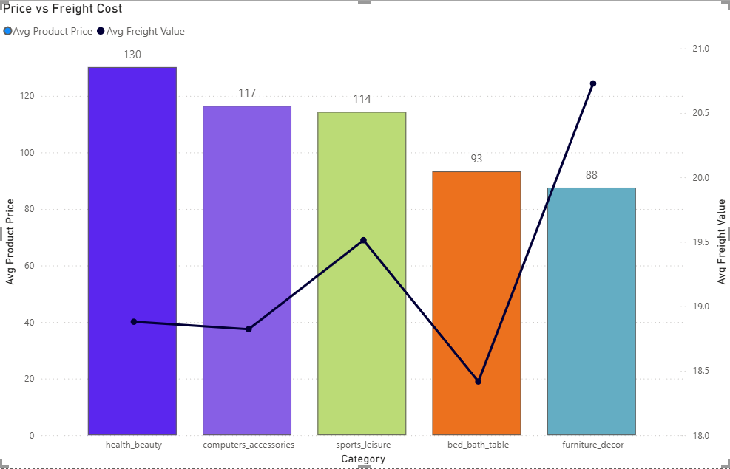
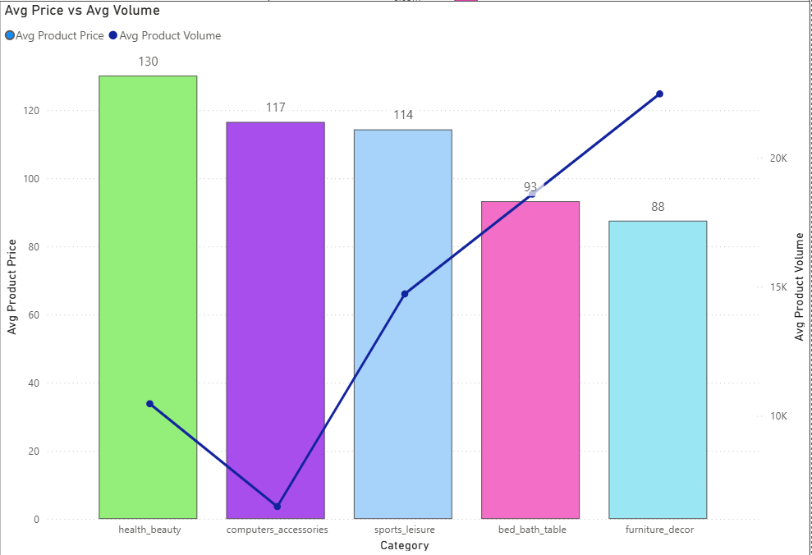
Recommendations:
High-Volume/Low-Price Strategy: Optimize logistics for Furniture & Decor to reduce high freight costs and maximize profitability.
Low-Volume/High-Price Strategy: For Health & Beauty, explore product bundling or subscriptions to increase average order volume without reducing the high product price.

Slide 6
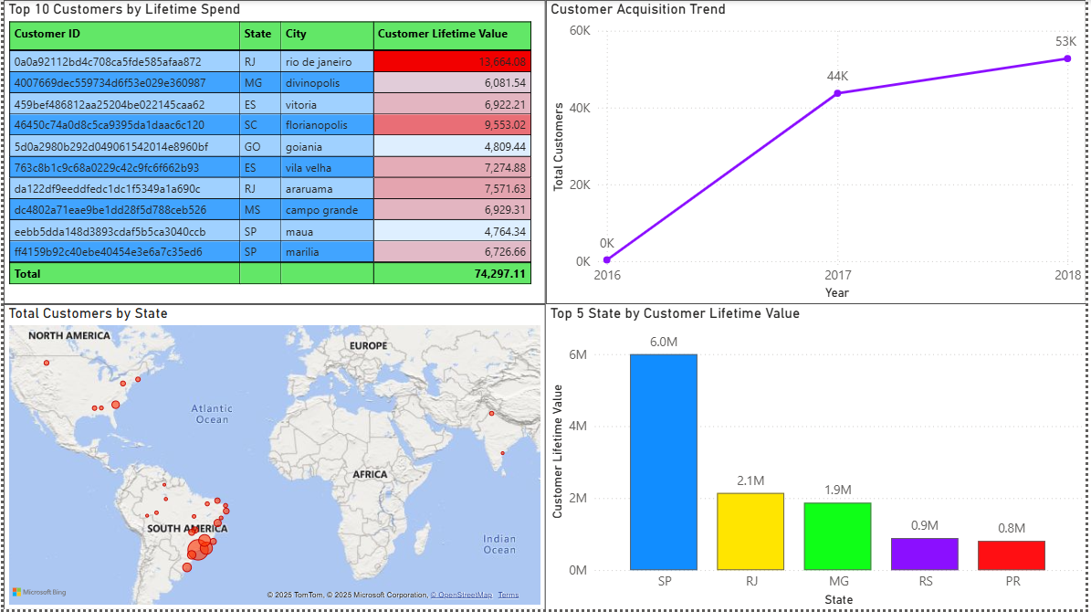
Customer & CLV Analysis
Key Insights:
Customer Acquisition:
  Grew from 0K in 2016 to 53K in 2018.
  Monthly acquisition peaked at 7.4K customers in January 2018.
  Significant drop-off towards end of 2018 (down to 0.8K).
Geographic CLV Concentration:
  Sao Paulo (SP): $6.0M CLV.
  Rio de Janeiro (RJ): $2.1M CLV.
  High reliance on SP confirmed.
Top Customers: Top 10 customers have total CLV of $74,297.11, with top individual customer at $13,664.08 .
Note: CLV stands for Customer Lifetime Value.

Slide 7
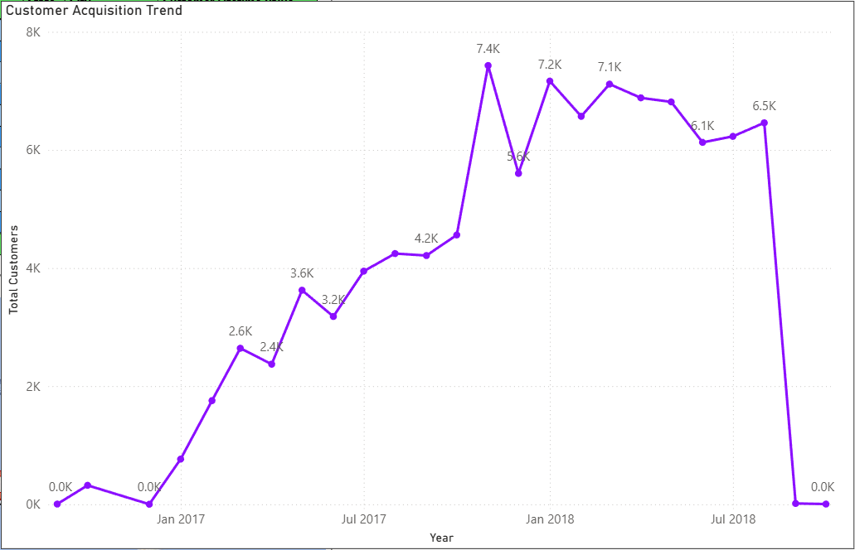
Recommendations:
CLV Expansion:
  Target campaigns in high-potential states (MG: $1.9M CLV, RS: $0.9M CLV).
  Convert new customers into repeat buyers to decrease over-reliance on SP.
Churn Mitigation: Investigate reasons for significant drop in customer acquisition in latter half of 2018:
  Marketing spend changes
  Competitor activity
  Technical issues

Slide 8
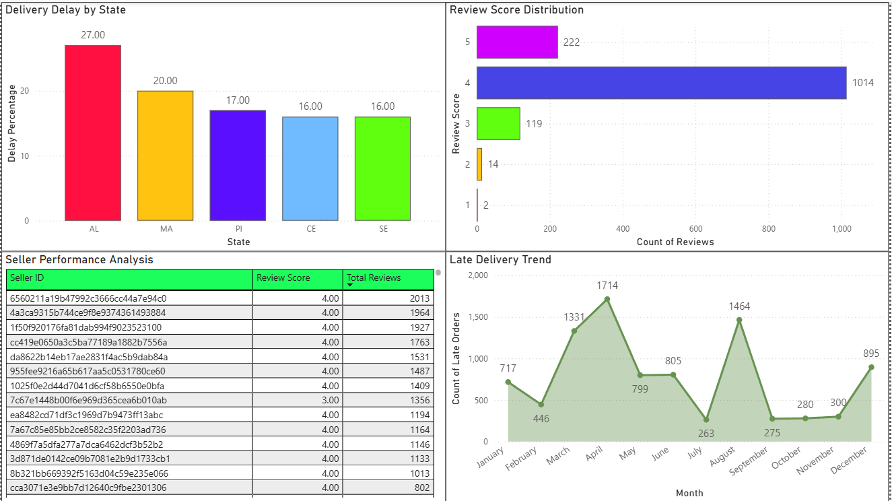
Seller & Delivery Analysis
Key Insights:
High Review Score:
  Average review score: 4.09
  Distribution skewed toward positive ratings (1,014 reviews at 4 stars, 222 at 5 stars)
  Only 16 reviews are 2-stars or 1-star
Seller Performance:
  Top sellers maintain excellent Review Score of 4.00
  Top seller has 2,013 total reviews
Delivery Delay Volatility:
  High monthly fluctuation
  Peak in April (1,714) and August (1,464)
Highest Delay States:
  AL: 27.00%
  MA: 20.00%
  PI: 17.00%

Slide 9
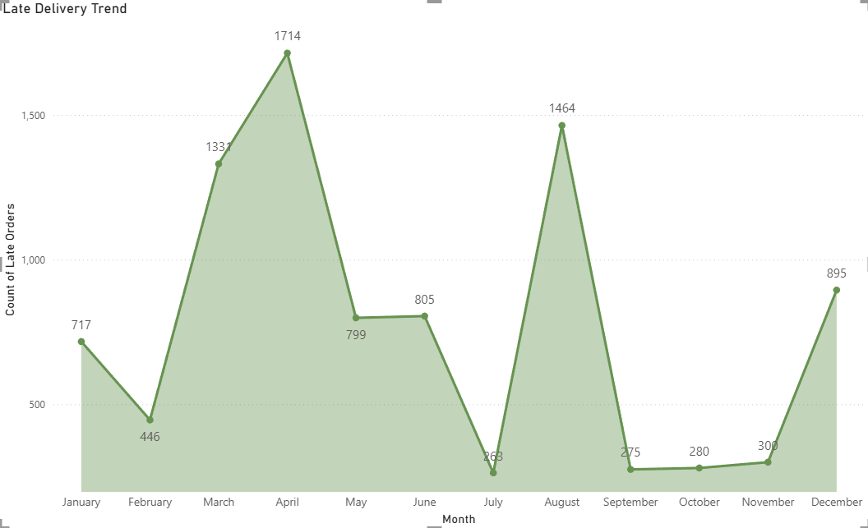
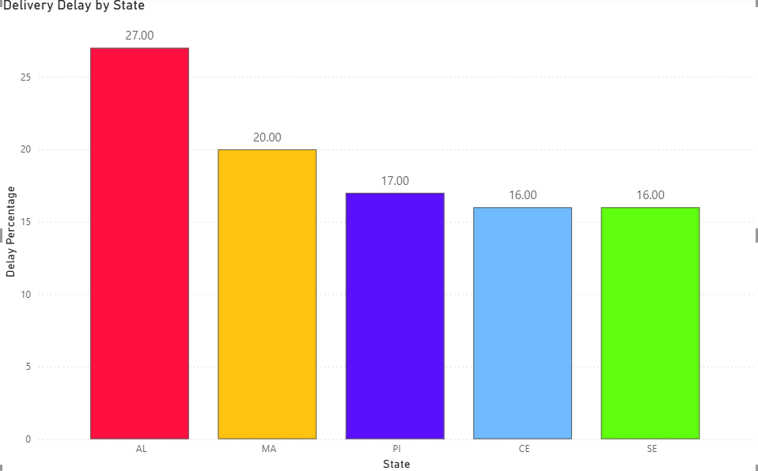
Recommendations:
Logistics Deep-Dive:
  Focus on April and August to identify and resolve root causes of delivery spikes.
  Consider increasing carrier capacity or changing primary carrier during these months.
High-Risk State Intervention:
  Prioritize improving logistics in AL, MA, and PI.
  Offer premium shipping options in these states.
  Partner with local, reliable carriers to reduce delay percentages.

Slide 10
Final Recommendations
Category | Key Insight Summary | Final Recommendation | Business Impact
Sales Growth & Stability | Revenue is growing strongly (up to $8.45M in 2018), but Orders drop sharply in Q4 (18.2K orders), indicating high seasonal volatility. | Launch a Strategic Q4 Sales Campaign focused on promotions/discounts to stabilize order volume and prevent the year-end decline. | Maintain consistent revenue flow and maximize annual order count.
Logistics & Delivery | Late orders peak consistently in April and August. State AL has the highest delay percentage (27%). | Conduct a Root Cause Analysis on carrier performance in April/August and establish a premium/local carrier partnership for high-delay states (AL, MA, PI). | Protect the strong 4.09 Avg Review Score and reduce customer complaints related to delivery.
Customer Acquisition | Customer acquisition shows a significant drop-off in the latter half of 2018 (from 7.4K to 0.8K customers/month). | Investigate and Address the 2018 Acquisition Decline by reviewing marketing spend, competitive landscape, and channel performance during that period. | Ensure a steady pipeline of new customers to sustain the overall revenue growth trend.
Geographic Strategy | Sao Paulo (SP) dominates both Total Revenue and Customer Lifetime Value ($6.0M CLV), creating high geographic risk. | Shift Marketing Spend to increase customer acquisition in states with lower CLV but high potential (e.g., MG, RS) to diversify the customer base. | Mitigate geographic risk and unlock new, untapped markets for long-term value.
Product Strategy | High-price Health & Beauty has low volume. Low-price Furniture & Decor has the highest volume but also the highest freight cost. | For Health & Beauty, implement subscription/bundling to increase volume. For Furniture & Decor, optimize shipping methods to reduce freight cost. | Improve profitability for both high-value (price) and high-volume product categories.

